Slide 1
Basics of UnrealEngine
by Roberto Baldi

Slide 2

Who am I?
Roberto Baldi
Programmer at 34BigThings
Email: rbaldi@34bigthings.com

Slide 3

Unreal Engine

Slide 4




What is a Game Engine?
Game loop
Rendering
Physics
Editor
Sound
Scripting language
Import and export
Build and packaging

Slide 5
Why Unreal Engine?
Widely used
Open source
Forum and big community
Fortnite

Slide 6
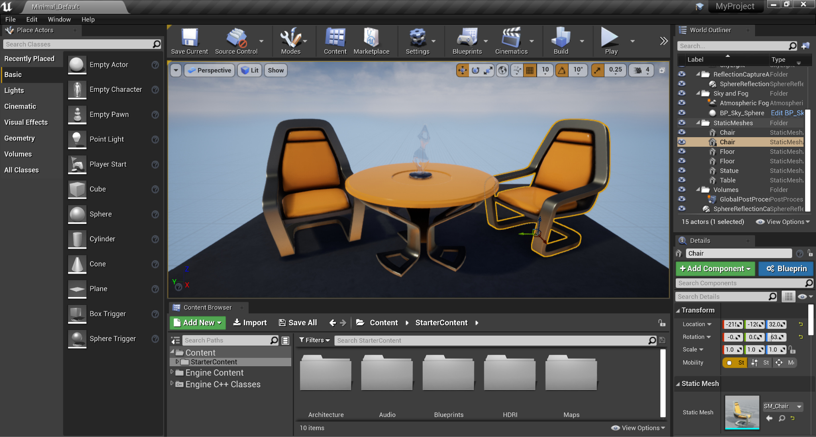
Editor
Viewport
World Outliner
Content Browser
Details
Place Actors
Play
Project Settings

Slide 7

Example #1
Create a new level
Place actors
Place PlayerStart
Play

Slide 8
Game Framework

Slide 9
Basic context
Object: base UE Class
Actor: base UE for object that exist in a Scene
ActorComponents: functionalities for an Actor
StaticMesh: a 3D geometric object
Material: aesthetic asset applicable to a Mesh
Blueprints

Slide 10
Game context
GameEngine: Init, Loop, Travels, ..
EditorEngine: a GameEngine for Editor
GameInstance: flow of the Game
LocalPlayer: Controller/Net Id
Subsystem/Interfaces: Singletons for specific requirements

Slide 11
Level context
Level: World composition/logic and Settings
GameMode: dictate the of Match
GameState: state of the Match
PlayerState: state of a Player
Controller (AI/Player): representation of the Player
Pawn: realization of the actions of a Controller
Character: a Pawn with Human-like properties

Slide 12
Generic context
Project settings
Input Actions and Mapping Context
DataTables
Physics (PhysX or Chaos)
Landscape Tool
Niagara: particle system of UE
Behavior Trees
Garbage Collector

Slide 13
Blueprints

Slide 14
What is and Why a Blueprint
UE Visual Programming Language
Instantiable
Many operators
Events base

Slide 15
How to Blueprints
Begin Play
Tick
Variables and Visibility
Methods
Delay
InputActions

Slide 16
Example #2
Create GameMode
Create Pawn
Create Controller
Movement (Keyboard Event)
Input Actions

Slide 17
Debug Blueprints
Screentrace
Output Log
Breakpoints

Slide 18
More with Blueprints
Instantiate
Spawn other Blueprints
Hit/Overlap Events
Destroy / SetLifespan

Slide 19
Example #3
Create Projectile
Create Target
Point System

Slide 20
Materials

Slide 21
Material
Material
Texture
Parameters
Time
Operations

Slide 22
Physics

Slide 23
Physics
Profiles
Gravity
Debug
Cast
Collisions and overlaps
PhysX and Chaos

Slide 24
UI (User Interface)

Slide 25
HUD (Heads-up display)
PlayerController
Blueprint

Slide 26
Widgets
Design
Containers
Visibility
Blueprints

Slide 27
Marketplace

Slide 28
Project Structure
Engine
Game
Plugins
Modules

Slide 29
Marketplace
Assets
Plugins

Slide 30
The End.

